Slide 1
Draft Design Front-End

Slide 2
Pages:
Student (Parent)
Teacher
Sale, Reception
Finance
Self information
CEO, manager

Slide 3
1. Student (parent)
There is a tabview on the left side, which contains 3 tabs:
Schedule (main page when student log in): contains information about classes, time, room,… UI of it looks like calendar in outlook.
Progress of classes: which is help students and parents keep tracking about progress of their involved during enrolling the English center.
E-learning: lists down every courses that student involved. In each class, there are documents, videos, books,… Those documents will be uploaded by the teacher and also exercises from student.
There is a button for students make attendance every time they join the class. UI of it also looks like a calendar.

Slide 4
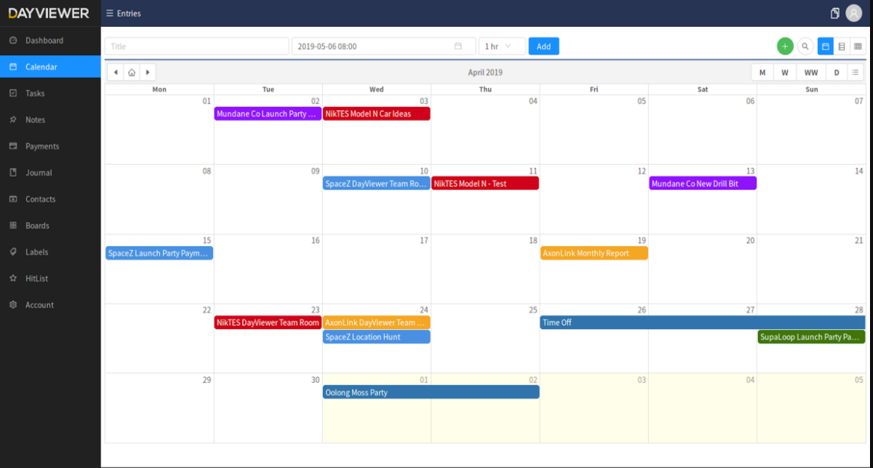
1.1 Schedule (calendar)

Slide 5
1.2 Progress

Slide 6
1.3 E-Learning

Slide 7
2. Teacher
There is a tabview on the left side, contains

